Slide 1
Spectral Clustering
Kanchan Luitel
ENCS 6010 (Advanced Applied Mathematics)
11/17/2021

Slide 2
Outline
Introduction – Clustering (Recap)
Motivation
Comparison (K means vs. Spectral clustering)
Algorithm Implementation
Observation
Code Simulation
Challenges
Questions

Slide 3
Introduction
Unsupervised Learning
- no labels needed
- helps with discovering hidden patterns in the data
Cluster Analysis
- Group together similar instances
- Approaches to cluster analysis
- compactness and connectivity

Slide 4
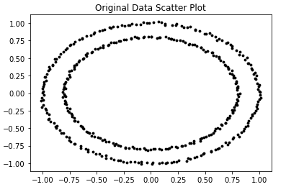
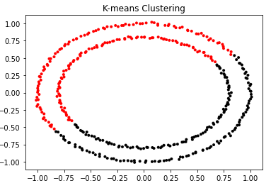
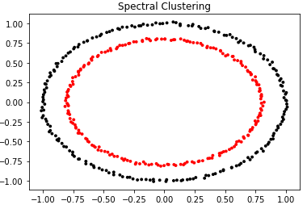
Clustering - Motivation
Clustering
-compactness and connectivity
Applications
market segmentation, social network analysis, search result grouping, medical imaging, image segmentation, anomaly detection, Data Compression, Privacy Preservation ( Google )

Slide 5
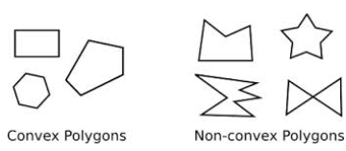
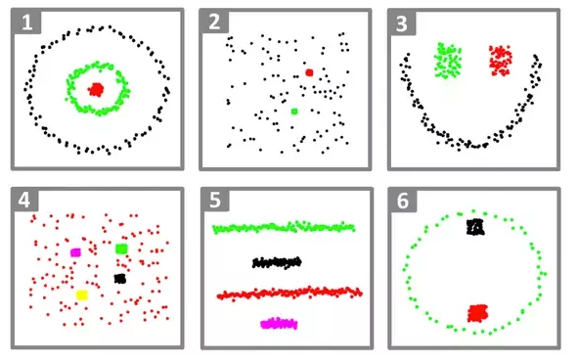
Graph Clustering
K-means clustering
- most popular clustering algorithms
- “k” number of centroid adjusted in iterative process to find clusters
Limitations of K-means clustering
Requires number of clusters to be known in advance
Struggles when clusters have irregular non-convex shapes
Will always produce an answer finding the required number of clusters even if the data isn’t clustered (or clustered in that many clusters).
Requires linear cluster boundaries
It requires multiple restarts at times to find the local minima (i.e., the best clustering).

Slide 6
Similarity Graphs
Given a set of data points x₁, …X_{n} and some notion of similarity s_{ij} >= 0 between all pairs of data points xi and xj, the intuitive goal of clustering is to divide the data points into several groups such that points in the same group are similar and points in different groups are dissimilar to each other¹.
Sets as vectors: Measure similarity by the cosine distance
Sets as sets: Measure similarity by the Jaccard distance
Sets as points: Measure similarity by Euclidean distance
When constructing similarity graphs, the goal is to model the local neighborhood relationships between the data points.
The ε-neighborhood graph² – connect all points whose pairwise distances are smaller than ε
K-nearest neighbor graphs³ – connect vertex v_{i} with vertex v_{j} if v_{j} is among the k-nearest neighbors of v_{i}
3) The fully connected graph⁴ – connect all points with positive similarity with each other. As the graph should represent the local neighborhood relationships, this construction is only useful if similarity function itself models local neighborhood. Gaussian similarity function s(x_{i}, x_{j}) =exp(−x_{i} − x_{j})²/(2 σ ²), where the parameter σ controls the width of the neighborhoods.

Slide 7
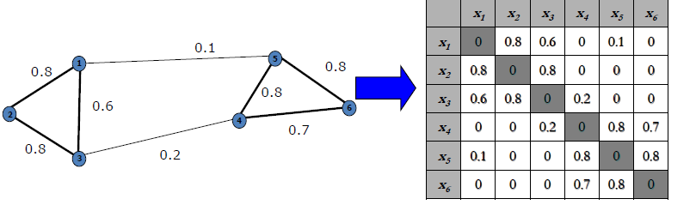
Similarity Matrix (W)

Slide 8
Degree Matrix(D)
a
Vertex
Adjacent Vertices
b
d
a
b, c, d
c
b
a, d
c
a, d
d
a, b, c
3 | 0 | 0 | 0
0 | 2 | 0 | 0
0 | 0 | 2 | 0
0 | 0 | 0 | 3

Slide 9
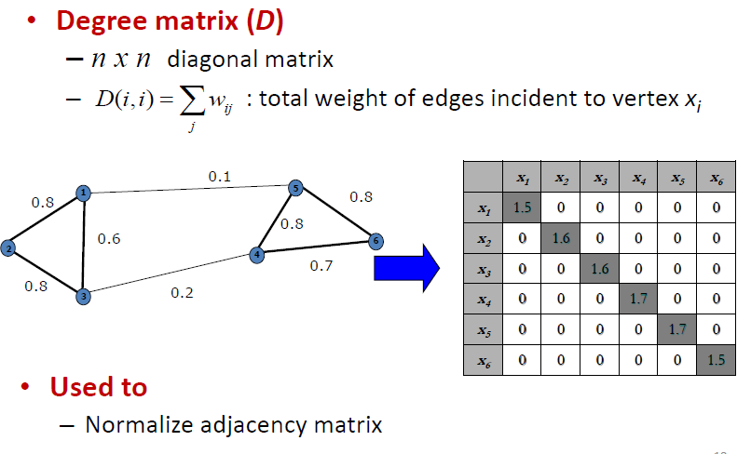
Degree Matrix(D)

Slide 10
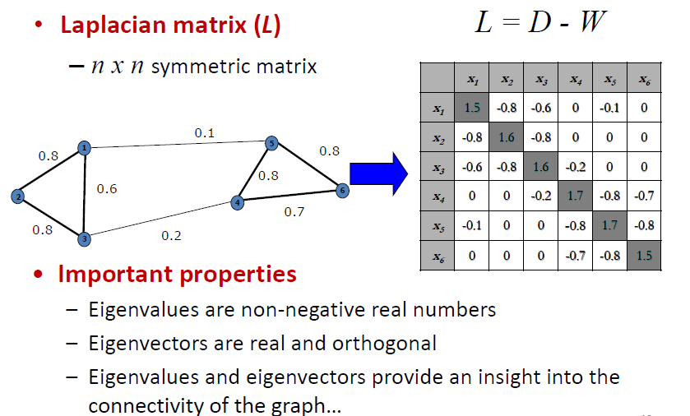
Laplacian Matrix of a Graph

Slide 11
Laplacian Matrix (L)
Unnormalized Form
---------------------------
Laplacian Matrix (L) = Degree Matrix(D) – Adjacency Matrix(A)
If weighted graph :
Laplacian Matrix (L) = Degree Matrix(D) – Similarity Matrix (W)
Normalized Laplacian Matrix Form¹
--------------------------------------------------
L_{sym} := D^{−1/2}LD^{−1/2} = I − D^{−1/2}WD^{−1/2}
L_{rw} := D⁻¹L = I − D⁻¹W

Slide 12
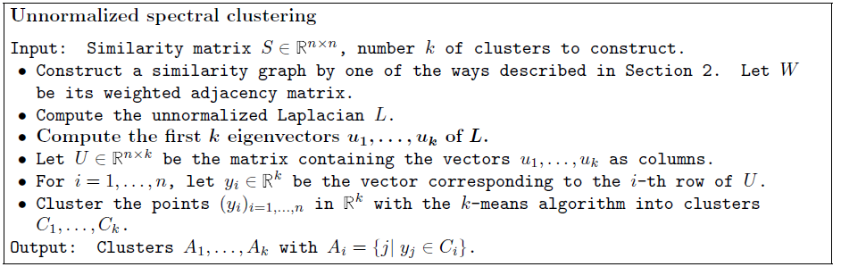
Spectral Clustering

Slide 13
Spectral Clustering - Observation
L has n non-negative, real-valued eigenvalues: 0 = 1 2 : : : n.¹
The smallest eigenvalue of L is λ₀=0 and the corresponding eigenvector is the constant one vector 1. Its multiplicity equals the number of connected components in the graph².
The first non-null eigenvalue k+1 is called the Fiedler value. The corresponding eigenvector u_{k+1} is called the Fiedler vector. The multiplicity of the Fiedler eigenvalue is always equal to 1. The Fiedler value is the algebraic connectivity of a graph, the
further from 0, the more connected. The Fidler vector has been extensively used for spectral bi-partitioning³.

Slide 14
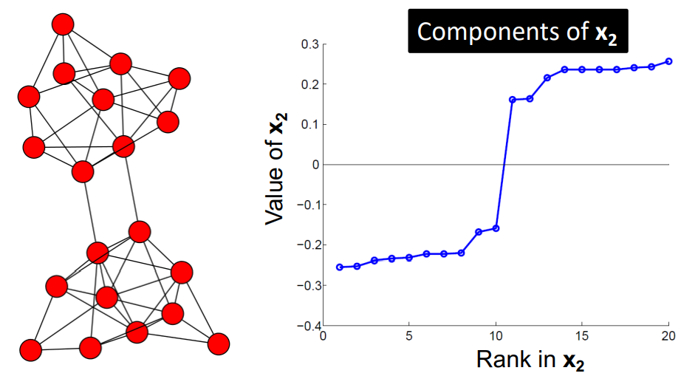
Fiedler Vector

Slide 15
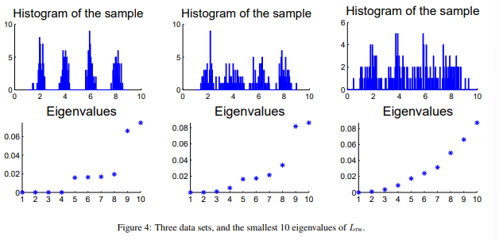
Spectral Clustering – Choosing number of Clusters
Choosing the number k of clusters :
Eigengap Heuristic
Here the goal is to choose the number k such that all eigenvalues λ1, . . . , λ_{k} are very small, but λ_{k+1} is relatively large.
Justification : (perturbation theory) In the ideal case of k completely disconnected clusters, the eigenvalue 0 has multiplicity k, and then there is a gap to the (k + 1)th eigenvalue k+1 > 0. (spectral graph theory) Here, many geometric invariants of the graph can be expressed or bounded with the help of the first eigenvalues of the graph Laplacian. In particular, the sizes of cuts are closely related to the size of the first eigenvalues.²

Slide 16
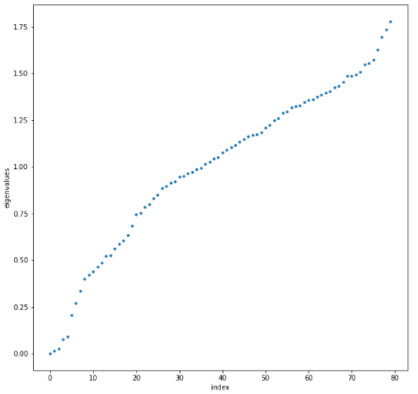
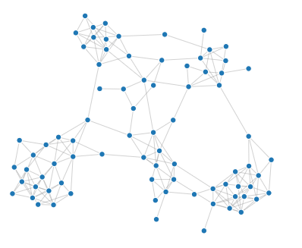
Program – Result
Graph representation of original data
Index vs eigenvalues

Slide 17
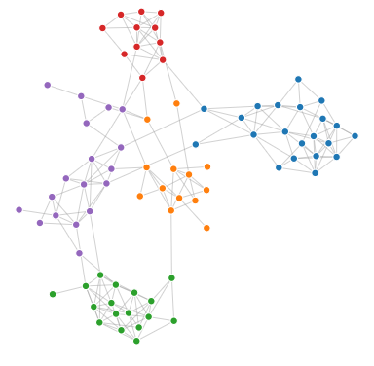
Program - Result
Graph after Spectral clustering

Slide 18
Challenges
Dealing with Big Data Set
Spectral clustering can be implemented efficiently if we make sure the similarity graph is sparse¹.
Approach:
1) Sparse Matrix : the sparsification method retains the “most useful” S_{ij} to form a sparse matrix to reduce memory use
2) Sub-matrix : several columns or rows of dense matrix e.g., Nyström approximation to avoid calculating the whole similarity matrix
3) Parallel Spectral Clustering³
Choosing a Good Similarity Graph
- Not trivial
- can be quite unstable under different choices of the parameters for the neighborhood graphs

Slide 19
Conclusion
Spectral clustering is helpful to cluster irregular non-convex shapes graph structure. Spectral clustering can be a slow algorithm for large data set so improved algorithm as suggested in challenges section should be used to speed it up.

